Slide 1
宏观经济学
中央财经大学2019年春季学期
第V篇：全球化背景下的宏观经济学
陈斌开

Slide 2
什么是开放经济
开放经济指一个国家与世界其它国家之间进行经济来往，对应于封闭经济。
物品跨国流动：国际贸易
资本跨国流动：国际金融

Slide 3
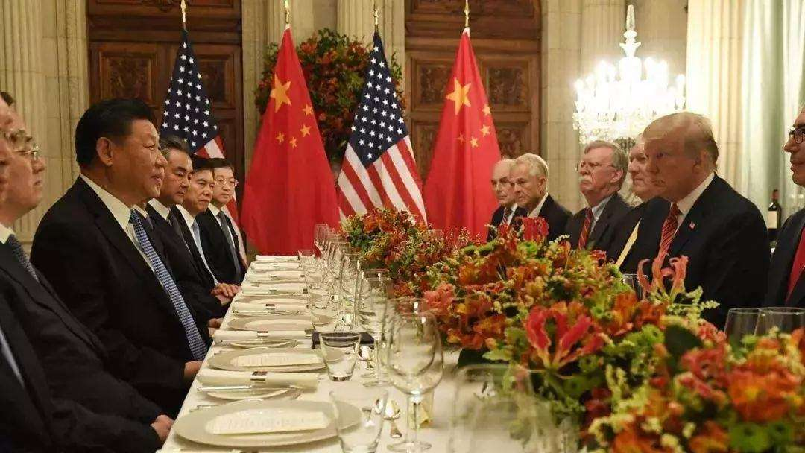

为什么要学习开放经济

Slide 4
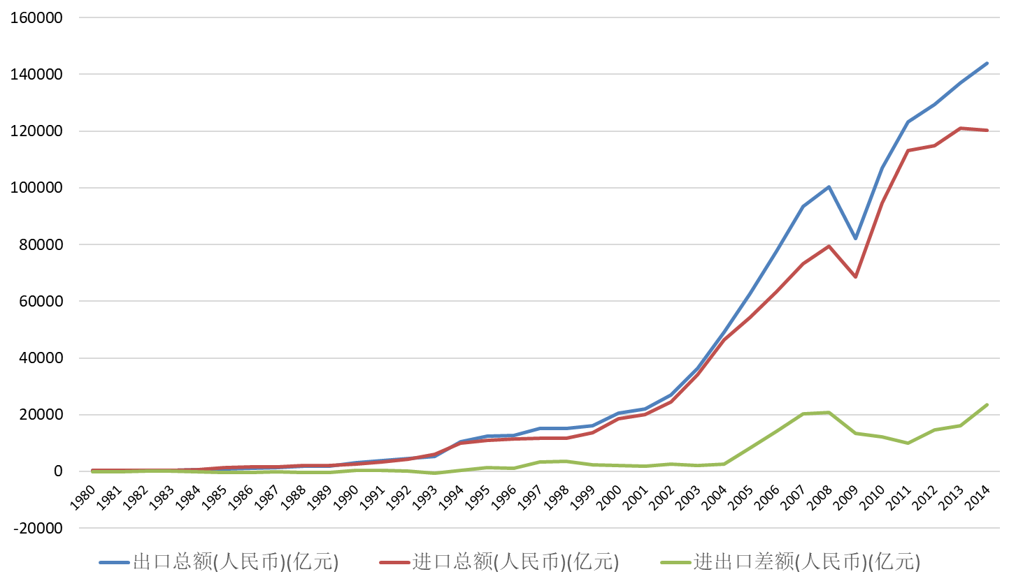
为什么要学习开放经济
数据来源：国家统计局网站

Slide 5
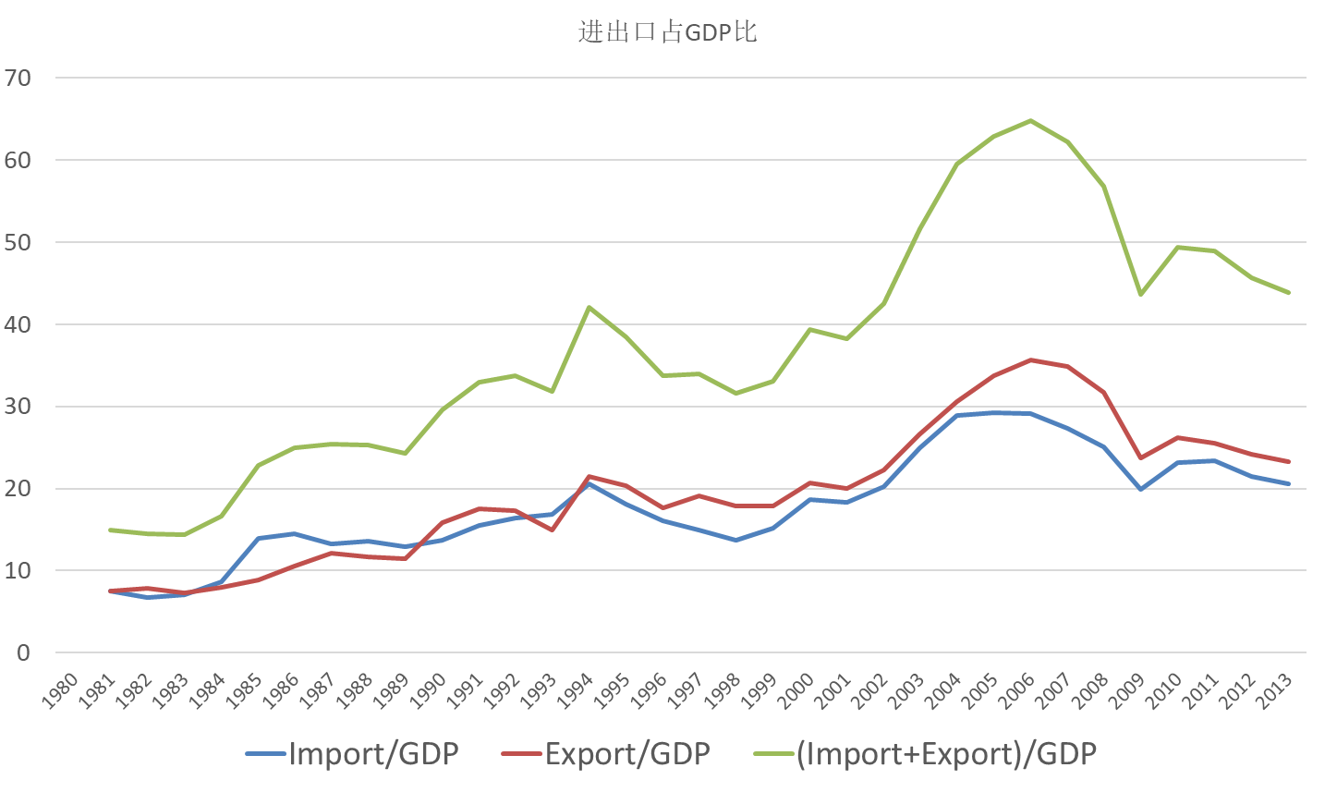
为什么要学习开放经济
数据来源：国家统计局网站

Slide 6
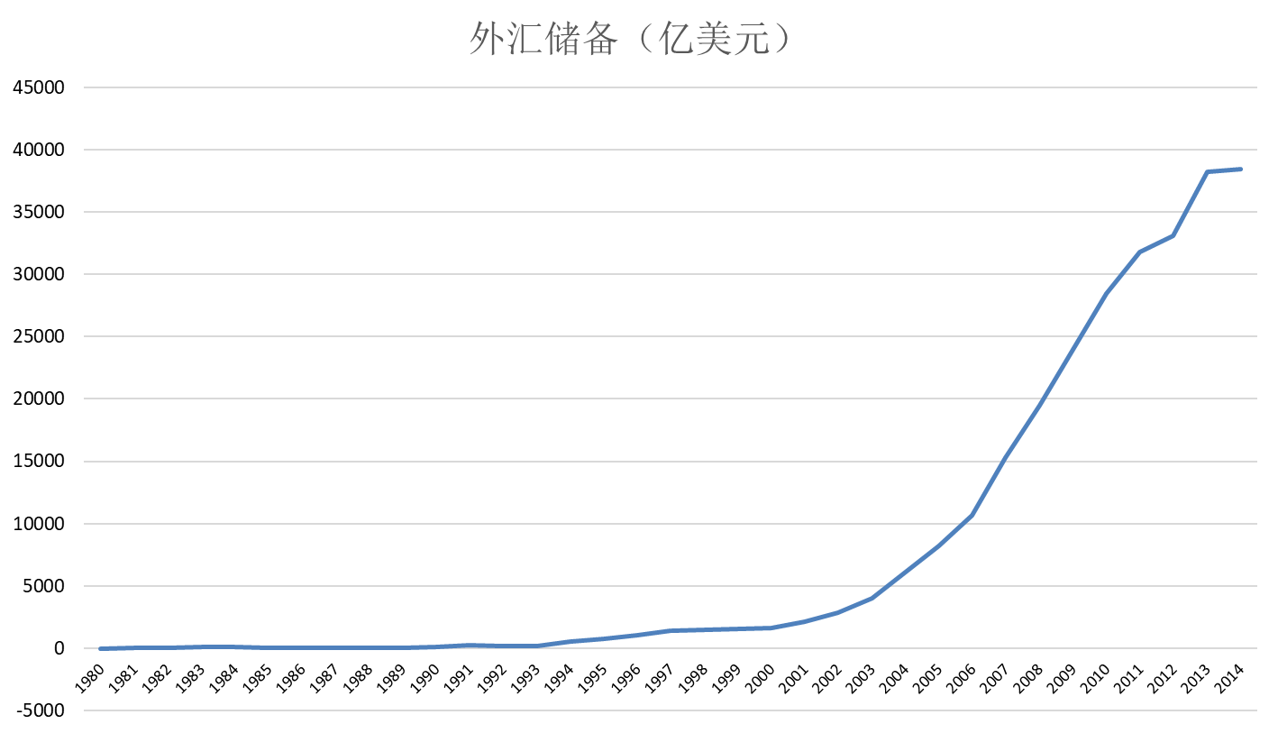
为什么要学习开放经济
数据来源：国家统计局网站

Slide 7
本篇内容
第14讲、开放经济条件下的古典理论和总需求理论
第15讲、汇率、利率和经常项目
第16讲、国际收支、金融危机与中国经济

Slide 8
第14讲：开放经济条件下的古典理论和总需求理论

Slide 9
本章目标
基本概念和古典理论
开放经济的国民收入恒等式
固定汇率和浮动汇率
名义汇率和实际汇率
购买力平价理论
开放宏观总需求理论：Mundell-Fleming 模型
slide <number>

Slide 10
开放经济下的国民收入核算恒等式
Y = C + I + G + NX
或者, NX = Y – (C + I + G )
国内支出
净出口
产出
slide <number>
Notes:
Solving this identity for NX yields the second equation, which says:
A country’s net exports---its net outflow of goods---equals the difference between its output and its expenditure.
Example: If we produce $500b worth of goods, and only buy $400b worth, then we export the remainder.
Of course, NX can be a negative number, which would occur if our spending exceeds our income/output.

Slide 11
国际资本流动
净资本外流
  S – I
  “信贷资金”的净外流
  对外国资产的净购买
  (本国购买外国资产 – 外国购买本国资产)
当 S > I时, 该国为净贷方
当S < I时,该国为净借方
slide <number>
Notes:
In Chapter 3, we examined a closed economy model of the loanable funds market. Savers could only lend money to domestic borrowers. Firms borrowing to finance their investment could only borrow from domestic savers. Thus, S = I.
But in an open economy, S need not equal I. A country’s supply of loanable funds can be used to finance domestic investment, or to finance foreign investment (e.g., buying bonds from a foreign company that needs funding to build a new factory in its country).
Similarly, domestic firms can finance their investment projects by borrowing loanable funds from domestic savers or by borrowing them from foreign savers.
International borrowing and lending is called “international capital flows” even though it’s not the physical capital that is flowing abroad-- we don’t see factories uprooted and shipped to Mexico (Ross Perot’s famous remark notwithstanding). Rather, what can flow internationally is “loanable funds,” or financial capital, which of course is used to finance the purchase of physical capital.
Note: foreign investment might involve the purchase of financial assets--stocks and bonds and so forth--or physical assets, such as direct ownership in office buildings or factories. In either case, a person in one country ends up owning part of the capital stock of another country.
The equation NFI = S – I shows that, if a country’s savers supply more funds than its firms wish to borrow for investment, the excess of loanable funds will flow abroad in the form of net foreign investment (the purchase of foreign assets). Alternatively, if firms wish to borrow more than domestic savers want to lend, then the firms borrow the excess on international financial markets; in this case, there’s a net inflow of loanable funds, and
NFI < 0.

Slide 12
产品流、资金流之间的联系：
资本账户和经常账户
NX = Y – (C + I + G )
暗示
NX = (Y – C – G ) – I
= S – I
贸易余额 = 净资本外流
因此,
一个国家贸易赤字 (NX < 0)
为净借方 (S < I ).
经常账户+资本账户=0
slide <number>
Notes:
Starting from the equation derived on slides 6 and 7, we can derive another important identity: NX = S – I
This equation says that
Net exports (the net outflow of goods) = net capital outflows (the net outflow of loanable funds)
While the identity and its derivation are very simple, we learn a very important lesson from it:
A country (such as the U.S.) with persistent, large trade deficits (NX < 0) also has low saving, relative to its investment, and is a net borrower of assets.

Slide 13
固定汇率和浮动汇率
在浮动汇率下，名义汇率e可以随着经济条件的变化而变化.
相反，在固定汇率下，中央银行将汇率维持在一个预先确定的水平.
有管理的浮动汇率制
slide <number>

Slide 14
名义汇率和实际汇率
e = 名义汇率,
两个国家通过的相对物价。
(例如，6人民币/美元，表示可用1美元兑换6人民币)
slide <number>
Notes:
Warning to students:
Some textbooks and newspapers define the exchange rate as the reciprocal of the one here (e.g., dollars per yen instead of yen per dollar). The one here is easier to use, because a rise in “e” corresponds to an “appreciation” of the country’s currency. Using the reciprocal would mean that a rise in “e” is a depreciation, which seems counter-intuitive.
So it would be worthwhile to point out to students that a country’s “e” is simply the price (measured in foreign currency) of a unit of that country’s currency.

Slide 15
名义汇率和实际汇率
= 实际汇率 是两国产品的相对物价。
(例如一個美国的麦当劳汉堡包可以换几个中国的麦当劳汉堡包)
ε
slide <number>

Slide 16
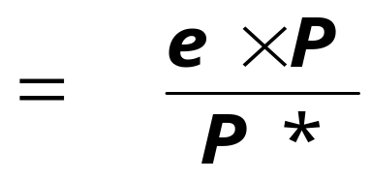
实际汇率 ε 的衡量单位
ε
(美元/人民币)( 1单位中国产品所值的人民币)
=
1单位美国产品所值的美元
1单位中国产品的美元价值
=
1单位美国产品的美元价值
=
1单位美国产品可以交换的中国产品数
slide <number>
Notes:
Students often have trouble understanding the units of the real exchange rate.
It’s worth explaining each line carefully, and making sure students understand it before displaying the next line.
Note: The examples here and in the text are in terms of one good, i.e., Big Macs. But P and P* are the overall price levels of the domestic and foreign countries. Thus, they each measure the price of a basket of goods.
When you get to the bottom line, emphasize that the real exchange rate measures the amount of purchasing power in Japan that must be sacrificed for each unit of purchasing power in the U.S.

Slide 17

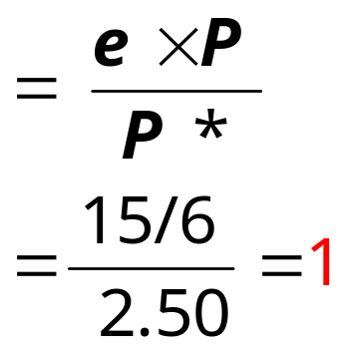
~ 以麦当劳为例 ~
一件产品: 巨无霸
在美国的价格:
P* = 2.5美元
在中国的价格:
P = 15人民币
名义汇率
e = 1/6 美元/人民币
一个中国游客在美国，必须支付1个中国巨无霸的金额，能在美国买一个巨无霸。
ε
slide <number>

Slide 18
购买力平价理论(PPP)
两个定义:
  定义一 :商品在各国的价格（调整币别后）必定相同 。
  定义二 :名义汇率会调整到所有国家一篮子商品的成本都相同。
理由:
  套利, 一价定律
slide <number>

Slide 19
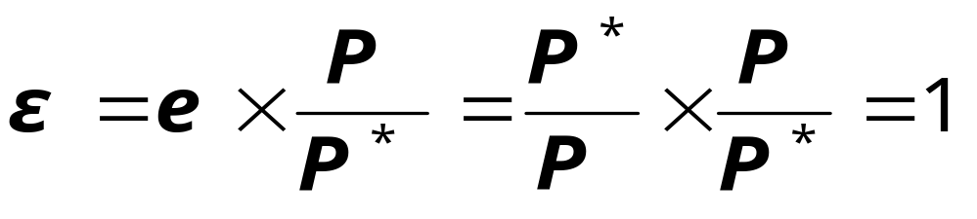
购买力平价理论(PPP)
PPP: e ×P = P*
以外国货币衡量的外国一篮子商品成本。
以外国货币衡量的本国一篮子商品成本。
以本国货币衡量的本国一篮子商品成本。
求解 e : e = P */P
购买力平价理论表明两国间的名义汇率会等于两国的价格水平.
slide <number>
Notes:
PPP implies that the cost of a basket of goods (even a basket with just one good, like a Big Mac or a latte) should be the same across countries.
e P = the foreign-currency cost of a basket of goods in the U.S., while P* the cost of a basket of foreign goods.
PPP implies that the baskets cost the same in both countries: eP = P*,
which implies that e = P*/P.

Slide 20
购买力平价在现实世界成立吗?
不, 理由如下:
  1. 国际上，套利空间并不总是存在.
    许多商品不存在交易
    交易成本存在
  2. 不同国家的商品之间不一定是完全可替代的
然而， 购买力平价仍然是一个有用的理论:
  购买力平价理论简单且直观
  在现实世界，两国间名义汇率在长期会等于两国购买力平价值。
slide <number>

Slide 21
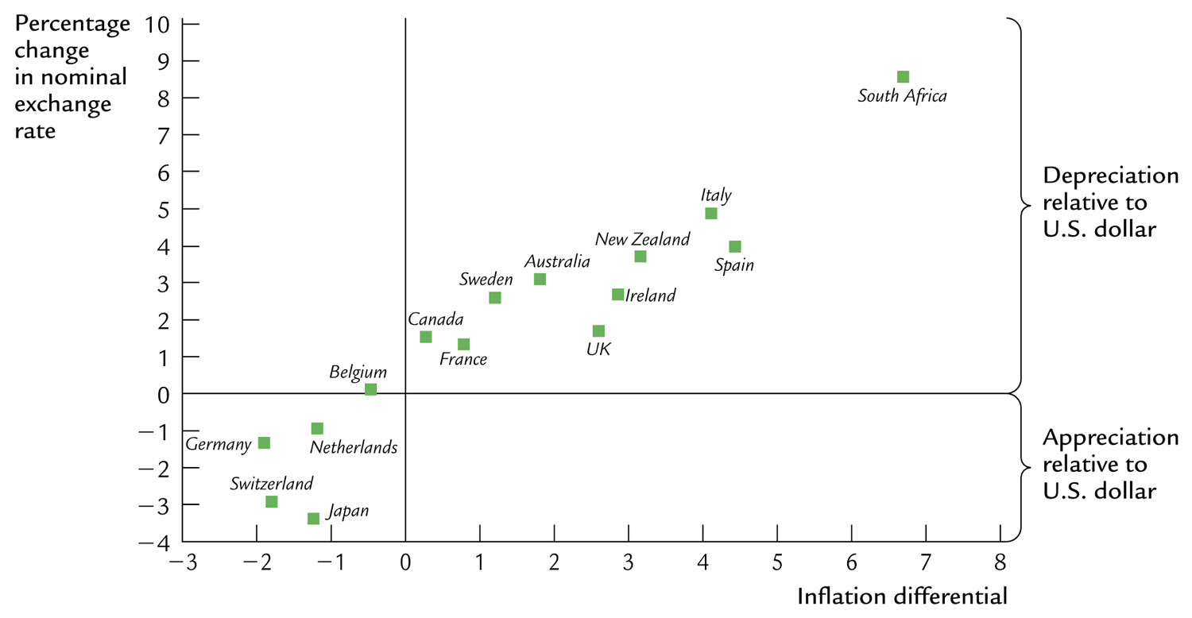
实际汇率与名义汇率
名义汇率变动的百分比
南非
相对于美元贬值
意大利
新西兰
澳大利亚
西班牙
瑞典
爱尔兰
加拿大
法国
英国
比利时
德国
荷兰
相对于美元升值
瑞士
日本
通货膨胀率的差别
通货膨胀率的差别与汇率
slide <number>
Notes:
Figure 5-13 on p.137. The horizontal axis measures the country’s inflation rate minus the U.S. inflation rate. The vertical axis measures the percentage change in the U.S. dollar exchange rate with that country.
This figure shows a very clear relationship between the inflation differential and the rate of dollar appreciation.

Slide 22
Mundell-Fleming Model

Slide 23
蒙代尔一弗莱明模型
假设: 开放经济条件下资本完全流动
即 ：r = r* （国内利率等于世界利率）
商品市场均衡时的IS曲线：
e 是名义汇率，即两国货币之间的比率
slide <number>
Notes:
In this and the following sections (in which we analyze policies with the M-F model), we assume the price level is fixed---just as we did when we first used the closed economy IS-LM model to do policy analysis in Chapter 11.
As we learned in Chapter 5, NX depends on the real exchange rate. However, with price levels fixed, the real & nominal exchange rates move together.
So, for simplicity, we write NX as a function of the nominal exchange rate here.
(At the end of this chapter, when we use M-F to derive the aggregate demand curve, we go back to writing NX as a function of the real exchange rate, because the nominal & real exchange rates may behave differently when the price level is changing.)
Chapter 5 introduced the notation r* for the world interest rate, and explained why r = r* in a small open economy with perfect capital mobility.
Perfect capital mobility means that there are no restrictions on the international flow of financial capital: the country’s residents can borrow or lend as much as they wish in the world financial markets; and because the country is small, the amount its residents borrow or lend in the world financial market has no impact on the world interest rate.
Chapter 5 also explained why net exports depend negatively on the exchange rate.

Slide 24
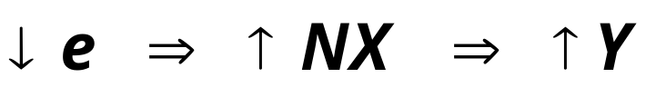
商品市场均衡时的 IS曲线:
■ 给定均衡利率 r*的IS曲线向右下倾斜（如右图）：
■ 倾斜原因:
e
IS*
Y
slide <number>
Notes:
Again, “eq’m” is an abbreviation for “equilibrium.”
The text (p. 315) shows how the Keynesian Cross can be used to derive the IS* curve.
Suggestion: Before continuing, ask your students to figure out what happens to this IS* curve if taxes are reduced.
Answer: The IS* curve shifts rightward (i. e., upward).
Explanation: Start at any point on the initial IS* curve. At this point, initially, Y = C + I + G + NX. Now cut taxes. At the initial value of Y, disposable income is higher, causing consumption to be higher. Other things equal, the goods market is out of whack: C + I + G + NX > Y. An increase in Y (of just the right amount) would restore equilibrium. Hence, each value of e is associated with a larger value of Y. OR, a decrease in NX of just the right amount would restore equilibrium at the initial value of Y. But the decrease in NX requires an increase in e. Hence, each value of Y is associated with a higher value of e.
Rationale: Doing this exercise now will break up your lecture, and will prepare students for the fiscal policy experiment that is coming up in just a few slides.

Slide 25
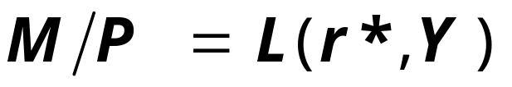
货币市场均衡时的 LM 曲线
给定均衡利率r*。
LM曲线是垂直的:
因为给定了 r*, 且货币供给是外生的，则只有唯一的Y 值与货币需求相对应，而与汇率e 无关。
e
LM*
Y
slide <number>
Notes:
The text (p.316) shows how the LM curve in (Y,r) space, together with the fixed r*, determines the value of Y at which the LM* curve here is vertical.
Suggestion: Before continuing, ask your students to figure out what happens to this LM* curve if the money supply is increased.
Answer: LM* shifts to the right.
Explanation: The equation for the LM* curve is:
M/P = L(r*, Y)
P is fixed, r* is exogenous, the central bank sets M, then Y must adjust to equate money demand (L) with money supply (M/P).
Now, if M is raised, then money demand must rise to restore equilibrium (remember: P is fixed). A fall in r would cause money demand to rise, but in a small open economy, r = r* is exogenous. Hence, the only way to restore equilibrium is for Y to rise.
Rationale: Doing this exercise now will break up your lecture, and will prepare students for the monetary policy experiment that is coming up in just a few slides.

Slide 26
蒙代尔一弗莱明模型中的均衡
e
LM*
均衡汇率
IS*
Y
均衡收入水平
slide <number>

Slide 27
固定汇率和浮动汇率
在浮动汇率下，名义汇率e可以随着经济条件的变化而变化.
相反，在固定汇率下，中央银行将汇率维持在一个预先确定的水平.
slide <number>

Slide 28

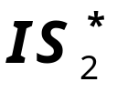
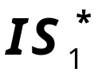
浮动汇率下的财政政策
e
■ 在任意给定的e下，扩张的财政政策将使IS曲线右移。
e₂
e₁
■ 结果:
Δe > 0, ΔY = 0
（IS曲线右下倾斜，LM曲线垂直）
Y
Y₁
slide <number>
Notes:
Intuition for the shift in IS*:
At a given value of e (and hence NX), an increase in G causes an increase in the value of Y that equates planned expenditure with actual expenditure.
Intuition for the results:
As we learned in earlier chapters, a fiscal expansion puts upward pressure on the country’s interest rate. In a small open economy with perfect capital mobility, as soon as the domestic interest rate rises even the tiniest bit about the world rate, tons of foreign (financial) capital will flow in to take advantage of the rate difference. But for foreigners to buy these U.S. bonds, they must first acquire U.S. dollars. Hence, the capital inflows result in an increase in foreign demand for dollars in the foreign exchange market, causing the dollar to appreciate. This appreciation makes exports more expensive to foreigners, and imports cheaper to people at home, and thus causes NX to fall. The fall in NX offsets the effect of the fiscal expansion.
How do we know that ΔY = 0? Because maintaining equilibrium in the money market requires that Y be unchanged: the fiscal expansion does not affect either the real money supply (M/P) or the world interest rate (because this economy is “small”). Hence, any change in income would throw the money market out of whack. So, the exchange rate has to rise until NX has fallen enough to perfectly offset the expansionary impact of the fiscal policy on output.

Slide 29
浮动汇率下的财政政策效果
在资本完全流动的情况下，财政政策无效，不能影响实际GDP。
挤出效应：
  封闭经济：
  扩张的财政政策造成利率上升，挤出私人投资。
  开放经济：
  扩张的财政政策造成汇率上升，导致净出口减少。
slide <number>

Slide 30

浮动汇率下的货币政策
e
■ 货币供给M 增加，LM 曲 线右移，国民收入Y 增加.
e₁
■ 结果:
Δe < 0, ΔY > 0
e₂
Y
Y₁
Y₂
slide <number>
Notes:
Suggestion: Treat this experiment as an in-class exercise. Display the graph with the initial equilibrium. Then give students 2-3 minutes to use the model to determine the effects of an increase in M on e and Y.
Intuition for the rightward LM* shift:
At the initial (r*,Y), an increase in M throws the money market out of whack. To restore equilibrium, either Y must rise, or the interest rate must fall, or some combination of the two. In a small open economy, though, the interest rate cannot fall. So Y must rise to restore equilibrium in the money market.
Intuition for the results:
Initially, the increase in the money supply puts downward pressure on the interest rate. (In a closed economy, the interest rate would fall.) Because the economy is small and open, when the interest rate tries to fall below r*, savers send their loanable funds to the world financial market. This capital outflow causes the exchange rate to fall, which causes NX-- and hence Y--to increase.

Slide 31
浮动汇率下的货币政策效果
货币政策影响产出的政策传导机制:
  封闭经济: ↑M ⇒ ↓r ⇒ ↑I ⇒ ↑Y
  开放经济: ↑M ⇒ ↓e ⇒ ↑NX ⇒ ↑Y
扩张的货币政策不会改变世界总需求，是不同国家间需求的转移。
即：开放经济下，一国通过扩张的货币政策来增加本国的国民收入和减少失业，是以别的国家的损失为代价的，是以邻为壑的政策。
slide <number>
Notes:
Suggestion:
Before revealing the text on this slide, ask students to take out a piece of paper and answer this question:
“Contrast the way in which monetary policy affects output in the closed economy with the small open economy.” Or something to that effect.

Slide 32
固定汇率
在固定汇率下，一国中央银行根据外汇的供求状况买进和卖出本币，从而把汇率维持在一个固定的水平上。
在蒙代尔一弗莱明模型中, 中央银行根据需要移动 LM 曲线，将汇率e 保持在预先宣布的水平。
长期内，在固定汇率制下，当实际价格发生变化时，虽然名义汇率固定不变，但实际汇率将发生改变。
slide <number>

Slide 33
固定汇率下的财政政策
■ 在浮动汇率下，财政政策失效。但在固定汇率下，财政政策有完全的效果。
e
■ 扩张的财政政策将使IS曲线右移，汇率有上浮的压力，中央银行为了维持汇率的稳定，就会卖出本币，即LM曲线右移。收入水平增加。
e₁
■ 结果:
Δe = 0, ΔY > 0
Y
Y₁
Y₂
slide <number>

Slide 34
固定汇率下的货币政策
■ 在浮动汇率下，货币政策完全有效。但在固定汇率下，货币政策无效。
■ 扩张的货币政策将使LM曲线右移，汇率有下浮的压力，中央银行为了维持汇率的稳定，就会卖出外币，买入本币，即LM曲线左移直到回到原处。收入水平不变。
e
e₁
■ 结果:
Δe = 0, ΔY = 0
Y
Y₁
slide <number>
Notes:
The monetary expansion puts downward pressure on the exchange rate. To prevent it from falling, the central bank starts buying domestic currency in greater quantities to “prop up” the value of the currency in foreign exchange markets. This buying removes domestic currency from circulation, causing the money supply to fall, which shifts the LM* curve back.
Another way of looking at it: to keep the exchange rate fixed, the central bank must use monetary policy to shift LM* as required so that the intersection of LM* and IS* always occurs at the desired exchange rate. Unless the IS* curve shifts right (an experiment we are not considering now), the central bank simply cannot increase the money supply.

Slide 35
开放经济条件下政策效果总结:
 | 汇率制度
 | 浮动汇率制 |  |  | 固定汇率制
 | 政策效果
政策 | Y | e | NX | Y | e | NX
扩张的财政政策 | 0 | ↑ | ↓ | ↑ | 0 | 0
扩张的货币政策 | ↑ | ↓ | ↑ | 0 | 0 | 0
slide <number>
Notes:
Table 12-1 on p. 327. (“M-F” = “Mundell-Fleming”)
This table makes it easy to see that the effects of policies depend very much on whether exchange rates are fixed or flexible.

Slide 36
固定汇率和浮动汇率的比较
关于浮动汇率的争论:
可以保持独立的货币政策，追求经济稳定增长、低通货膨胀等宏观经济目标。
关于固定汇率的争论:
降低不确定性，便于国际交往；
规则的货币政策可以防止货币供给过度增长和恶性通货膨涨。
slide <number>

Slide 37

蒙代尔—弗莱明模型和总需求曲线
在此以前，蒙代尔—弗莱明模型中，价格P 是固定不变的；
接下来:将考虑价格变化的影响，进而推到总需求曲线；
现在，蒙代尔—弗莱明模型的表达式为:
slide <number>
Notes:
Net exports really depend on the real exchange rate, not the nominal exchange rate. Earlier in the chapter, we wrote NX as a function of the nominal rate, because the price level was assumed fixed, so the nominal & real rates always moved together. But now, with the price level changing also, we need to write NX as a function of the real exchange rate.

Slide 38
总需求曲线（AD）的推导
ε
LM*(P₂)
LM*(P₁)
AD 曲线右下方
倾斜的原因：
ε₂
ε₁
↑P
⇒ ↓(M/P )
IS*
⇒ LM 向左移动
Y₂
Y₁
Y
P
⇒ ↑ε
P₂
⇒ ↓NX
P₁
⇒ ↓Y
AD
Y₂
Y₁
Y
slide <number>
Notes:
Like figure 12-12 on p.336, except here we are showing what happens to Y when P increases (not falls).
The derivation of the open economy AD curve is very similar to that of the closed economy AD curve (see chapter 11).

Slide 39
大型国家: 介于封闭和完全开放之间
很多国家包括中国，既不是封闭型的国家，也不是完全开放型的国家；
大型国家是介于完全开放和完全封闭两极之间的；
假定实施扩张的货币政策:
  在封闭经济中，
  ΔM > 0 ⇒ ↓r ⇒ ↑I
  在完全开放经济中，
  ΔM > 0 ⇒ ↓ε ⇒ ↑NX
slide <number>
Notes:
For more details, see the Appendix to Chapter 12 (not included in this PowerPoint presentation).

Slide 40
本章小结
国民所得恒等式:
  Y = C + I + G + NX
  贸易余额 NX = 净资本外流 S - I
2. 汇率
  名义汇率: 一国家通货与另一国家通货的交换比率
  实际汇率: 一国家商品与另一国家商品的交换比率
  实际汇率等于名义汇率乘以两个国家物价水平的比例。
slide <number>

Slide 41
本章小结
3. 蒙代尔—弗莱明模型：
  完全开放条件下的IS—LM 模型；
  假定P 是给定的；
  经济政策以及其他冲击对国民收入和汇率的影响。
4. 财政政策：
  固定汇率下有效，可以影响实际收入和产出；而浮动汇率下无效。
slide <number>

Slide 42
本章小结
5. 货币政策：
  浮动汇率下影响实际收入水平；
  固定汇率下，货币政策不能影响产出水平。
6. 固定汇率制和浮动汇率制的比较：
  在浮动汇率下，可以运用独立的货币政策达到一定的宏观经济目标，而不是只维持汇率的稳定；
  在浮动汇率下，可以降低国际交易的不确定性。
slide <number>

Slide 43
谢谢！

